Slide 1

MARKET STOCK PRİCE SYSTEM
BAŞAK KARADENİZ-1000319598

Slide 2

Purpose
The purpose of the system is to provide its users with an independent and convenient marketplace for grocery products.
This system mainly targets wholesale sellers and large storage companies on behalf of their target buyers.
With this situation, thanks to our system, buyers have a flexible storage space and users can easily access and make changes to a lot of information from their products to their sellers through the system.

Slide 3


Actors of the System
Super-user: By the definition of our system, a super-user is a person who manages a company and buyers of our system
User-1: User 1 is the people in the unit who can access the entries of the products sold in the company using the system.
User-2: User 2, unlike user 1, controls the outputs of the products but they also have the right to view the stock system, such as user 1 and, of course, super-user.
User -3: User 3's permissions are slightly different from other users. They can only log in to the system and access the statistics of product sales and purchases, acting only on the instructions of the super-user.

Slide 4
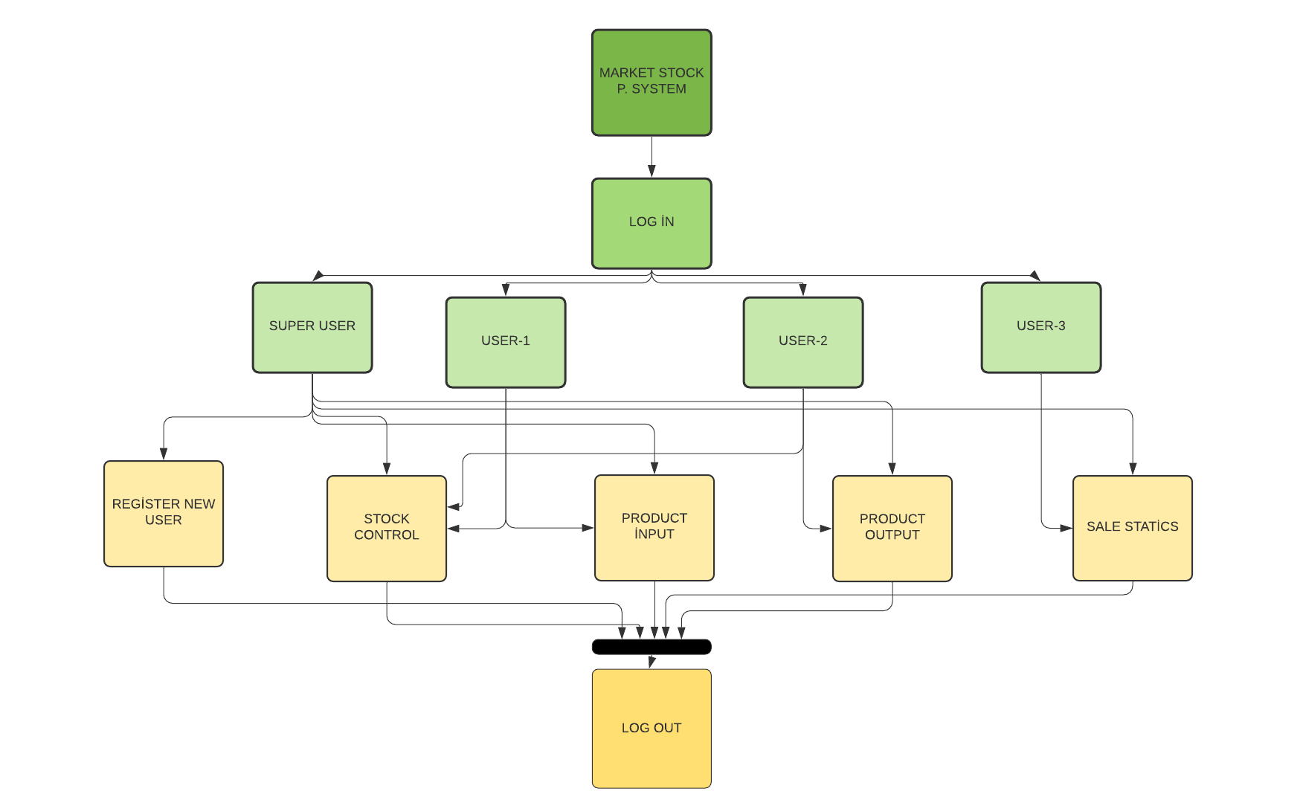
Operation of the system according to the entered users
From the moment of logging in to the system, the process of switching to the main menu will be the same as everyone who logs in to the system will see, but restrictions will be provided depending on the group in which the system login was created.

Slide 5



Programming Technologies Used
HTML
JavaScript
CSS

Slide 6

Functions
User input
Remembering the user
Error when the wrong user is entered
Adding a new user
Add a product entry
Adding product output
Filtering
Searching

